Slide 1
How to handle
Many-to-many relationships

Slide 2
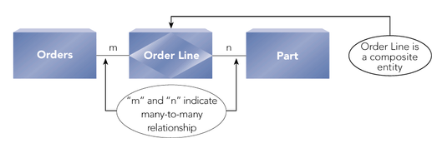
Lookup or Associative entity
Associative Entity:
Used to implement a many-to-many relationship
Can have additional attributes

Slide 3
Draw the E-R Diagram that best represents this application:
A hospital has many doctors who treat many patients. A doctor may treat several patients, or may not have any patients, such as an administrative doctor. A patient always has one doctor, but may be treated by a team of doctors. A doctor has an ID, Name, and specialty. A patient has a Patient number, Name, Address and age.

Slide 4
Underline the nouns—these may be entities in the ERD
A hospital has many doctors who treat many patients. A doctor may treat …
To decide if a noun will become an entity, ask yourself
this question: Is there more than one of them?
Hospital: No there is just one (so it does NOT become an entity)
Doctor – YES
Patient – YES (so these become entities)

Slide 5
The relationship is many-to-many (M-M):
DOCTOR
Treats
PATIENT
Treated by

Slide 6
Here is some sample data:
PatID | PatName | Addr | Age
P1 | Mary | … | 25
P2 | George | … | 34
P3 | Harry | … | 76
P4 | Sophie | … | 44
P5 | Lamisha | … | 31
DocID | DocName | Specialty
D1 | Joseph Fixit | heart
D2 | Sue Sewitup | orthopedic
D3 | Mac Quack | internist
Suppose that
D1 treats P2 and P3
D2 treats P1, P3, and P5
D3 treats P2, P4, and P5

Slide 7
D1 treats P2 and P3
D2 treats P1, P3, and P5
D3 treats P2, P4, and P5
DocID | PatID
D1 | P2
D1 | P3
D2 | P1
D2 | P3
D2 | P5
D3 | P2
D3 | P4
D3 | P5
This is the “associative entity”
because it associates one doctor
with one patient

Slide 8
Every time you have a M-M relationship…
You must convert it to show the associative entity between the two original entities
is converted to:
DOCTOR
Treats
PATIENT
Treated by
Treats
Doctor-
Patient
DOCTOR
PATIENT
Treated by

Slide 9
Now represent the attributes:
PATIENT
Pat_ID
Pat_Name
Pat_addr
Pat_age
Treats
Doctor-
Patient
DOCTOR
Doc_ID
Doc_Name
Doc_specialty
Treated by

Slide 10
PATIENT
Pat_ID
Pat_Name
Pat_addr
Pat_age
Treats
Doctor-
Patient
DOCTOR
Doc_ID
Doc_Name
Doc_specialty
Treated by
DocID | PatID
D1 | P2
D1 | P3
D2 | P1
D2 | P3
D2 | P5
D3 | P2
D3 | P4
D3 | P5
DocID | DocName | Specialty
D1 | Joseph Fixit | heart
D2 | Sue Sewitup | orthopedic
D3 | Mac Quack | internist
PatID | PatName | Addr | Age
P1 | Mary | … | 25
P2 | George | … | 34
P3 | Harry | … | 76
P4 | Sophie | … | 44
P5 | Lamisha | … | 31

Slide 11
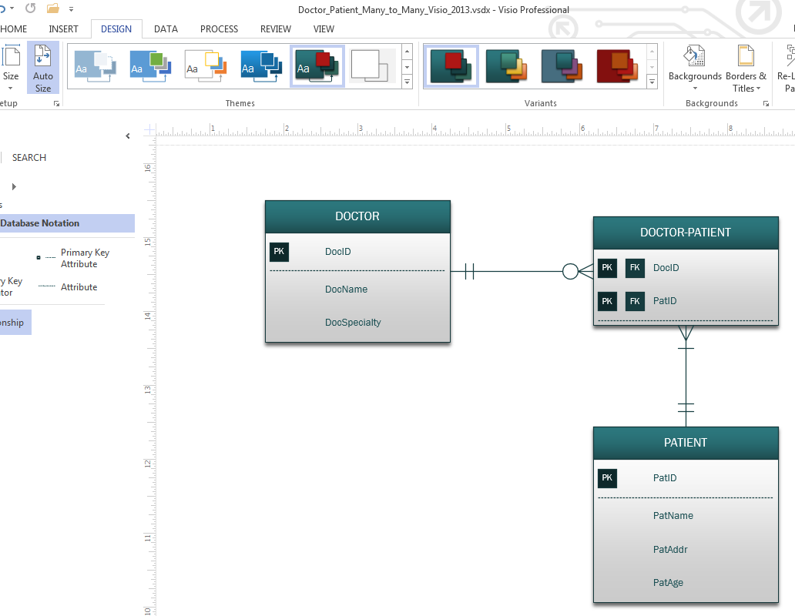
Draw ERD with Visio 2013

Slide 12
Another example:
Students take many classes; and each class has many students.
Convert the ERD to show the associative entity STUDENT-CLASS.
STUDENT
takes
CLASS
Taken by

